Slide 1
LECTURE 6
Q & A, Machine Learning

Slide 2
Agenda
Machine Learning
What is ML?
Examples
Q&A

Slide 3
Machine Learning
Notes:
Ask if anyone has ever heard of it
BRIEFFFF CONDENSED GUIDE TO ML

Slide 4
Machine Learning
Form of Artificial Intelligence where the machine is given data and the machine is then able to perform tasks base on what it learns from the data
Automates the data analysis process, so machine can make data informed prediction without human intervention
Four types of models: supervised, unsupervised, semi-supervised, reinforcement learning
Notes:
With the combination of statistical methods, algorithms can make classifications or predictions and uncover key insights in data mining projects

Slide 5
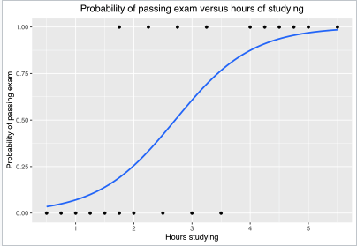
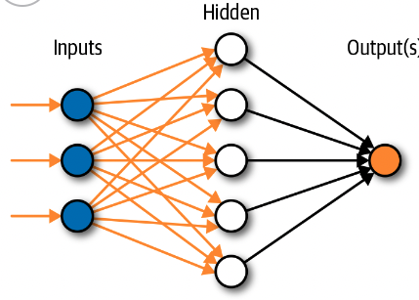
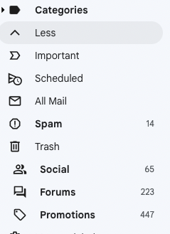
Supervised Learning
Labeled datasets to train algorithm to classify data or predict outcomes accurately
More data → model adjusts to fit appropriately
LINEAR REGRESSION is supervised learning!
Notes:
Logistic regression, neural network

Slide 6




Puppy or Bagel
Notes:
CLASSIFIER
https://quickdraw.withgoogle.com/

Slide 7
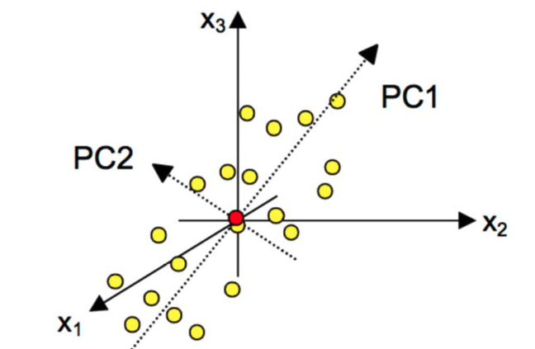
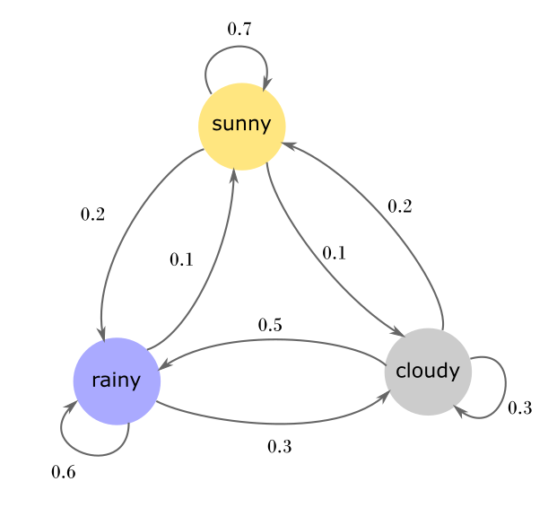
Unsupervised Learning
Analyze and cluster unlabeled data
Uncover hidden patterns or data groupings without the need for human intervention
Notes:
Principal components analysis, neural networks, markov chain → speech to text

Slide 8


Recommendations

Slide 9
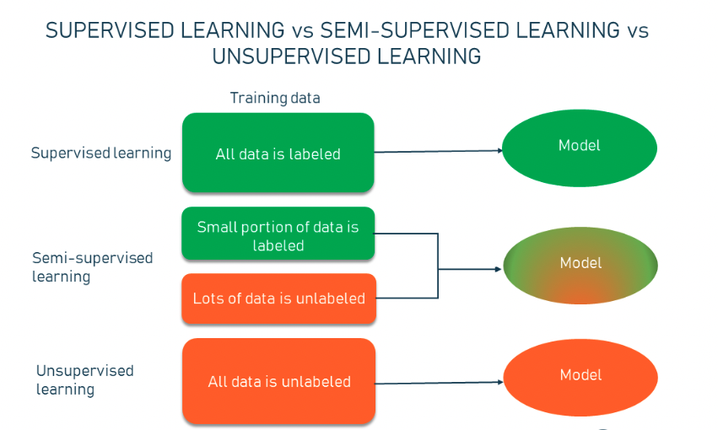
Semi-supervised Learning
Happy medium between supervised and unsupervised learning
Uses a smaller labeled data set to guide classification and feature extraction from a larger unlabeled data set
Notes:
solve the problem of not having enough labeled data for a supervised learning algorithm.
It also helps if it’s too costly to label enough data.

Slide 10

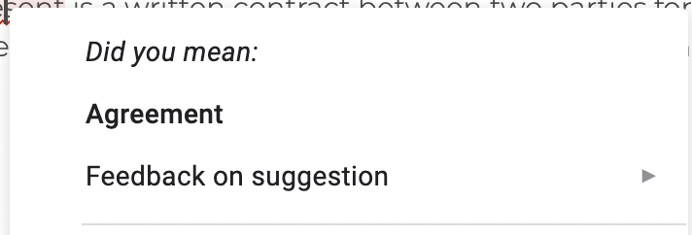
Autocomplete / Autocorrect
Notes:
Autocorrect on phones
Autofill in google
Take data from common searches
ALL USES DATA
Learn more about this in natural language processing

Slide 11
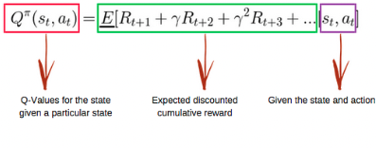
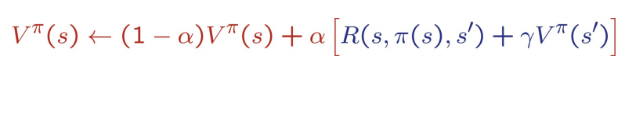
Reinforcement Learning
Closest to how humans learn
Algorithm or agent learns by interacting with its environment and getting positive or negative reward
Notes:
Q- learning, temporal difference value learning, neural networks (WOW WHAT CAN NEURAL NETWORKS NOT DO)
Lots of math → probability that is why statistic and linear algebra is important in ds (matrix)

Slide 12
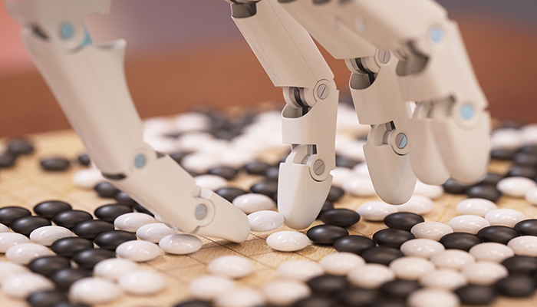
AlphaGo Zero
Notes:
Go originated in China over 3000 years ago and is a complicated strategy game
Two players take turn placing stones on a board and the goal is to surround and capture the opponent’s stone
If there are no more possible moves than the player with the most stones on the board wins
Sounds easy but there is a total of 10 to the power of 170 possible board configurations (ask how much possible boards there can be)
Most go ai play at the level of human amateurs
Standard ai methods cannot store and handle the amount of possible Go moves or evaluate the strength of each possible board positions
AlphaGo is the first computer program to defeat a professional human Go player, the first to defeat a Go world champion, and is arguably the strongest Go player in history
https://www.deepmind.com/research/highlighted-research/alphago

Slide 13
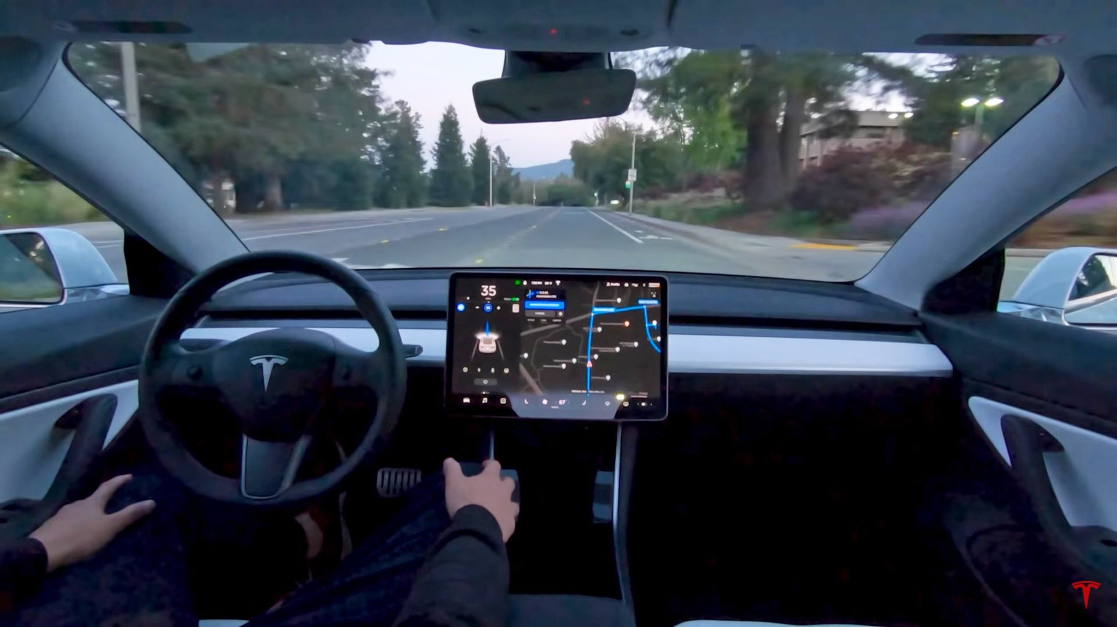
Self-driving Cars

Slide 14
Q & A
Notes:
where do you recommend practicing python?
Is calculus needed for data science? I know there's calc 1 and calc 2, do we need calc 2 knowledge?(calc 2 is harder)
What are some prompt suggestions/ideas to write about for the personal essay that can be the most outstanding?
Extracurricular about leadership(I personally have leadership positions such as the student government) compared to extracurriculars that interest me/I'm passionate about, which should I put first on the list of extracurriculars?
What's life like in CA? Compare CA to NYC, which would you prefer living in?(Just out of interest)
Since Danny said he is an economics major, I was wondering what ECs or other things he did in high school that helped with college apps. For reference, I am hoping to major in business as well.
Since I'm a rising senior, when you were applying to colleges through the common app, what do you recommend for the personal essay and supplements?

